Slide 1
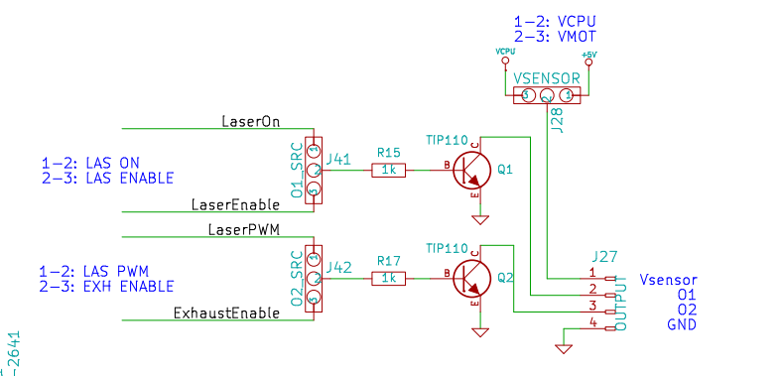
LaOS Relay circuit to control Air Assist Compressor and Exhaust fans
240 volts
AC Neg
Air Compressor/
Exhaust motor
240 volts
Earth
240 volts
AC Neg
Home made PCB
(Tracks shown in black)
Screw terminal blocks 2off
TERMINAL BLOCK 3.50MM 2 WAY
CAMDEN CTB3051/2BK
CPC part number CN11525
Diode 1off
1amp 50Volts
1N4001
Relay 1off
RELAY, POWER, PCB, 5V DC, 3A
TE CONNECTIVITY PCN-105D3MHZ
CPC part number SW04965

